Slide 1
Task 3: Simulating Finney Attack
Group 2

Slide 2
Introduction
This project simulates a simplified blockchain environment to demonstrate the concept of a Finney attack, a type of double-spending attack. Through an interactive user interface, participants can build a blockchain by adding transactions and mining blocks while observing how an attacker can exploit the system by pre-mining a fraudulent transaction. The simulation allows users to initiate a Finney attack, highlighting the vulnerabilities in blockchain systems that rely on the honest behavior of miners. By visualizing the blockchain's state before and after the attack, this project aims to educate users about the significance of security measures in decentralized networks.

Slide 3
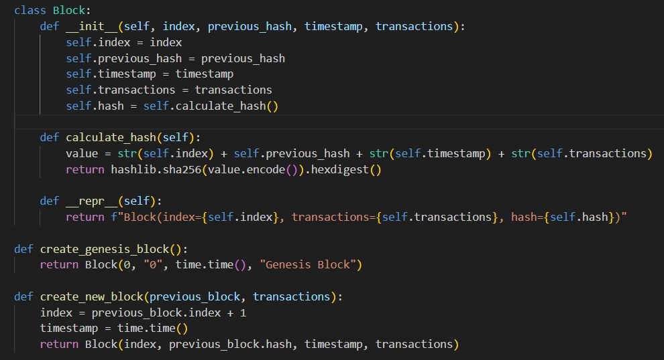
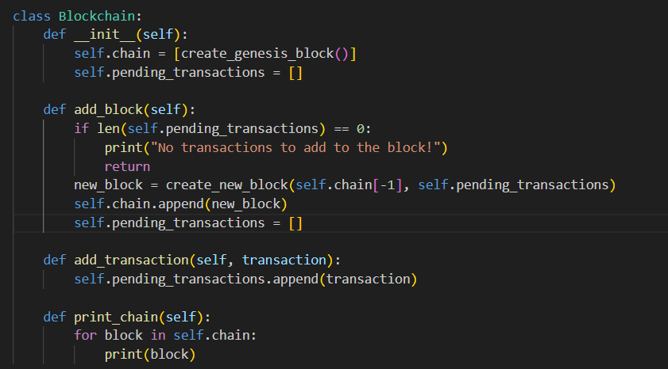
The Code
Block Class:
Purpose: This class represents a single block in the blockchain.
Each block contains attributes like its index, the hash of the previous block, a timestamp, and a list of transactions.
The class also includes a method to calculate its hash using SHA-256, ensuring the integrity of the block.
Importance: The Block class is essential because it encapsulates the structure and behavior of a block, which is fundamental to any blockchain implementation.
Blockchain Class:
Purpose: This class manages the entire blockchain. It contains a list of blocks (the chain) and a pool of pending transactions that are yet to be added to a block. It provides methods to add transactions, mine new blocks, and print the current state of the blockchain.
Importance: The Blockchain class is the core component that orchestrates the blockchain operations, allowing users to interact with and manipulate the chain, which is critical for demonstrating the Finney attack.

Slide 4
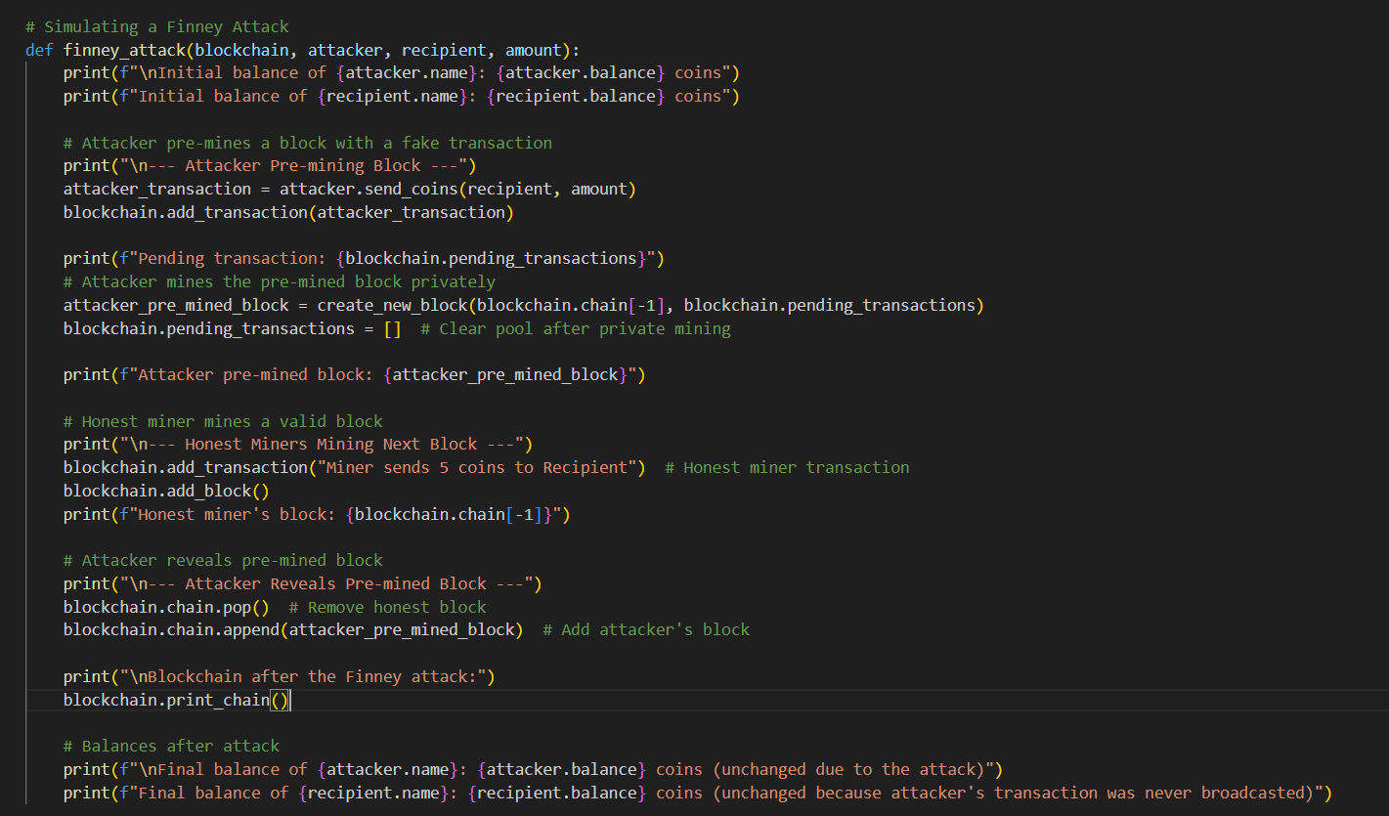
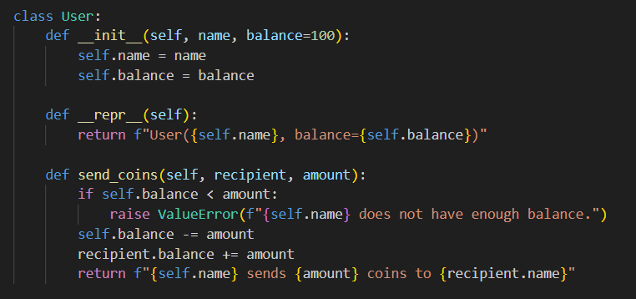
The Code
Finney Attack : Purpose: This function orchestrates the Finney attack simulation. It allows the attacker to pre-mine a block with a fraudulent transaction before the honest miners add their block. It then replaces the honest block with the attacker's pre-mined block, demonstrating the impact of the attack on the blockchain's integrity.
Importance: The finney_attack function is critical for illustrating the attack's mechanics, helping users understand how an attacker can manipulate the blockchain and the consequences of such vulnerabilities.
User Class:
Purpose: This class represents a user in the simulation, holding their name and balance. It includes a method for sending coins to another user, which updates their balances accordingly.
Importance: The User class is vital for simulating real-world scenarios of transactions and interactions between users in the blockchain, making it easier to illustrate the concept of the Finney attack.

Slide 5

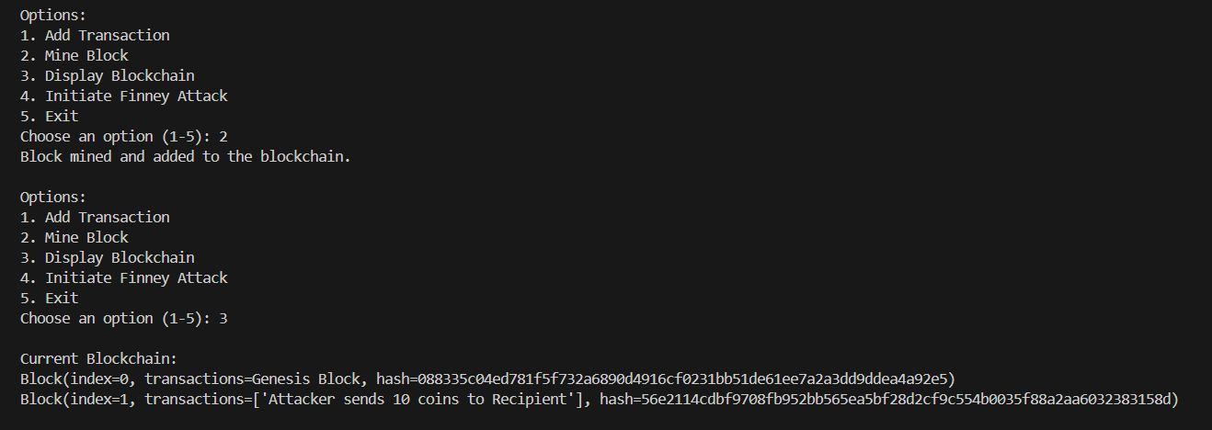
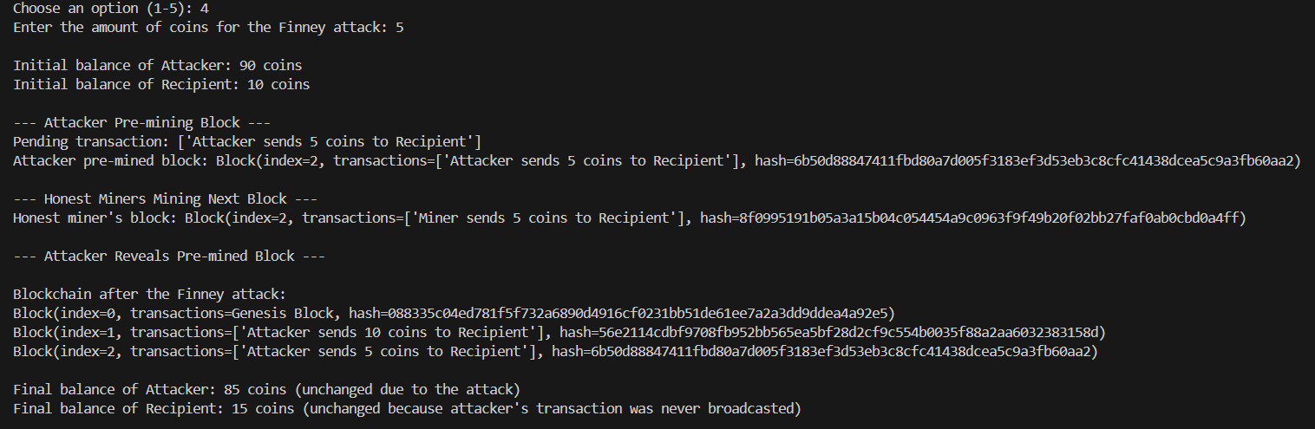
The Output

Slide 6
The Output
This simulation is menu-based, allowing users to interact with the blockchain by selecting various actions. Users can choose to create transactions, mine blocks, or initiate the Finney attack. The menu-driven structure guides the user through building the blockchain step-by-step, including adding new transactions, displaying the blockchain, and simulating the attack. When the Finney attack is initiated, the system walks the user through pre-mining the attacker’s block, letting honest miners mine a block, and then revealing the attacker’s block. This interaction helps users see the flow of events and understand how the attack manipulates the blockchain.
1. The blockchain starts with the genesis block, and the attacker has 100 coins while the recipient has 0 coins.
2. The attacker pre-mines a block with a transaction sending 10 coins to the recipient but keeps it private.
3. Meanwhile, an honest miner mines a legitimate block and adds it to the blockchain with unrelated transactions.
4. The attacker then reveals their pre-mined block, which replaces the honest miner’s block on the blockchain.
5. If the attack had not occurred, the attacker’s balance would have been 90 coins and the recipient’s 10 coins.
6. After the Finney attack, the attacker’s balance remains at 100 coins, and the recipient’s balance is unchanged at 10 coins due to the manipulation.

Slide 7
The Conclusion
In conclusion, this blockchain simulation effectively demonstrates how a Finney attack allows an attacker to manipulate the order of blocks to exploit the system without actually spending their coins. By pre-mining a fraudulent transaction and replacing an honest miner's block, the attacker retains their original balance, highlighting a critical vulnerability in blockchain networks when miners are not honest or transactions are not immediately broadcasted. This emphasizes the importance of robust consensus mechanisms to prevent such attacks.

